Slide 1
Feature Engineering
Geoff Hulten

Slide 2
Overview
Feature engineering overview
Common approaches to featurizing with text
Feature selection
Iterating and improving (and dealing with mistakes)

Slide 3
Goals of Feature Engineering
Convert ‘context’ -> input to learning algorithm.
Expose the structure of the concept to the learning algorithm.
Work well with the structure of the model the algorithm will create.
Balance number of features, complexity of concept, complexity of model.

Slide 4
Sample from SMS Spam
SMS Message (arbitrary text) -> 5 dimensional array of binary features
1 if message is longer than 40 chars, 0 otherwise
1 if message contains a digit, 0 otherwise
1 if message contains word ‘call’, 0 otherwise
1 if message contains word ‘to’, 0 otherwise
1 if message contains word ‘your’, 0 otherwise
“SIX chances to win CASH! From 100 to 20,000 pounds txt> CSH11 and send to 87575. Cost 150p/day, 6days, 16+ TsandCs apply Reply HL 4 info”
Long? | HasDigit? | ContainsWord(Call) | ContainsWord(to) | ContainsWord(your)

Slide 5
Basic Feature Types
Binary Features
ContainsWord(call)?
IsLongSMSMessage?
Contains(*#)?
ContainsPunctuation?
Categorical Features
FirstWordPOS ->
{ Verb, Noun, Other }
MessageLength ->
{ Short, Medium, Long, VeryLong }
TokenType ->
{ Number, URL, Word, Phone#, Unknown }
GrammarAnalysis ->
{ Fragment, SimpleSentence, ComplexSentence }
Numeric Features
CountOfWord(call)
MessageLength
FirstNumberInMessage
WritingGradeLevel

Slide 6
Converting Between Feature Types
numeric feature + single threshold => Binary Feature
Length of text + [ 40 ] => { 0, 1 }
numeric feature + set of thresholds => Categorical Feature
Length of text + [ 20, 40 ] => { short or medium or long }
categorical feature + one-hot encoding => Binary Features
{ short or medium or long } => [ 0, 0, 1] or [ 0, 1, 0] or [1, 0, 0]

Slide 7
Types of Features
System State
Settings [ high/low filter ]
Roaming?
Sensor readings
Content Analysis
Stuff we’ve been talking about
Stuff we’re going to talk about next
User Information
Industry
Demographics
Interaction History
User’s ‘report as junk’ rate
# previous interactions with sender
# messages sent/received
Metadata
Properties of phone #s referenced
Properties of the sender
Run other models on the content
Grammar
Language
…

Slide 8
Feature Engineering for Text
Tokenizing
Bag of Words
N-grams
TF-IDF
Embeddings
NLP

Slide 9
Tokenizing
Breaking text into words
“Nah, I don't think he goes to usf” ->
[ ‘Nah,’ ‘I’, ‘don't’, ‘think’, ‘he’, ‘goes’, ‘to’, ‘usf’ ]
Dealing with punctuation
“Nah,” ->
[ ‘Nah,’ ] or [ ‘Nah’, ‘,’ ] or [ ‘Nah’ ]
“don't” ->
[ ‘don't’ ] or [ ‘don’, ‘'’, ‘t’ ] or [ ‘don’, ‘t’ ] or [ ‘do’, ‘n't’ ]
Normalizing
“Nah,” ->
[ ‘Nah,’ ] or [ ‘nah,’ ]
“1452” ->
[ ‘1452’ ] or [ <number> ]

Slide 10
Bag of Words
Add one feature per word (token) that appears:
In the training set.
In some pre-selected dictionary.
[ feature selection, which we’ll talk about soon ]
Message 1: “Nah I don't think he goes to usf”
Message 2: “Text FA to 87121 to receive entry”
Nah | I | don't | think | he | goes | to | usf | Text | FA | 87121 | receive | entry
0 | 0 | 0 | 0 | 0 | 0 | 1 | 0 | 1 | 1 | 1 | 1 | 1
Message 2:
Use when you have a lot of data, can use many features

Slide 11
N-Grams: Tokens
Instead of using single tokens as features, use series of N tokens
“down the bank” vs “from the bank”
Message 1: “Nah I don't think he goes to usf”
Message 2: “Text FA to 87121 to receive entry”
Nah I | I don’t | don’t think | think he | he goes | goes to | to usf | … | Text FA | FA to | 87121 to | To receive | receive entry
0 | 0 | 0 | 0 | 0 | 0 | 0 | … | 1 | 1 | 1 | 1 | 1
Message 2:
Use when you have a LOT of data, can use MANY features

Slide 12
N-Grams: Characters
Instead of using series of tokens, use series of characters
Message 1: “Nah I don't think he goes to usf”
Message 2: “Text FA to 87121 to receive entry”
Na | ah | h <space> | <space> I | I <space> | <space> d | do | … | <space> e | en | nt | tr | ry
0 | 0 | 0 | 0 | 0 | 0 | 0 | … | 1 | 1 | 1 | 1 | 1
Message 2:
Helps with out of dictionary words & spelling errors
Fixed number of features for given N (but can be very large)

Slide 13
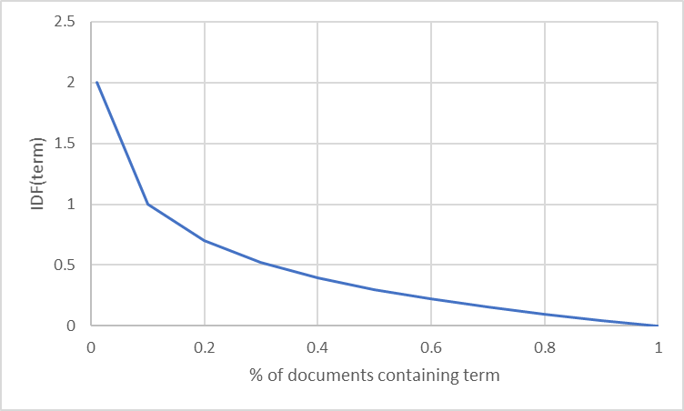
TF-IDF Term Frequency – Inverse Document Frequency
Instead of using binary: ContainsWord(<term>)
Use numeric importance score TF-IDF:
TermFrequency(<term>, <document>) =
% of the words in <document> that are <term>
InverseDocumentFrequency(<term>, <documents>) =
log ( # documents / # documents that contain <term> )
Words that occur in many documents have low score ($x_{i}$)

Slide 14
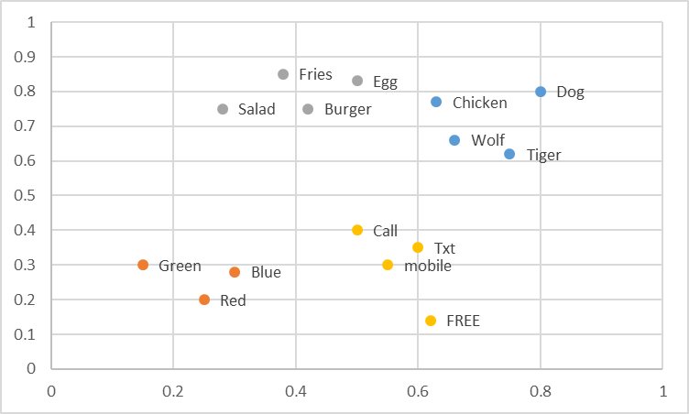
Embeddings -- Word2Vec and FastText
Word -> Coordinate in N dimension
Regions of space contain similar concepts
One Option: Average vector across words
Commonly used with neural networks
Replaces words with their ‘meanings’ – sparse -> dense representation

Slide 15
NLP
Parts of speech
Structure of sentences
Quality of writing
Language detection

Slide 16
Feature Selection
Which features to use?
How many features to use?
Approaches:
Frequency
Mutual Information
Accuracy

Slide 17
Feature Selection: Frequency
Take top N most common features in the training set
Feature | Count
to | 1745
you | 1526
I | 1369
a | 1337
the | 1007
and | 758
in | 400
… | …

Slide 18


Feature Selection: Mutual Information
Take N that contain most information about target on the training set
$$MI\left(X,Y\right)= \sum_{y∈Y}{\sum_{x∈X}{p\left(x,y\right)log(\frac{p(x,y)}{p\left(x\right)p(y)})}}$$
 | x=0 | x=1
y=0 | 5 | 0
y=1 | 0 | 5
 | x=0 | x=1
y=0 | 5 | 5
y=1 | 5 | 5
$$P\left(∗\right)= \frac{Obs\left(∗\right)+1}{N+2}$$
Notes:
Log(1) = 0
Log(2) ~ .3

Slide 19
Feature Selection: Mutual Information
Take N that contain most information about target on the training set
$$MI\left(X,Y\right)= \sum_{y∈Y}{\sum_{x∈X}{p\left(x,y\right)log(\frac{p(x,y)}{p\left(x\right)p(y)})}}$$
Feature | Mutual Information
Call | 0.128
to | 0.090
or | 0.055
FREE | 0.043
claim | 0.021
… | …
$$P\left(∗\right)= \frac{Obs\left(∗\right)+1}{N+2}$$
Notes:
Log(1) = 0
Log(2) ~ .3

Slide 20
Feature Selection: Accuracy (wrapper)
Take N that improve accuracy most on hold out data
Greedy search, adding or removing
From baseline, try adding (removing) each candidate
Build a model
Evaluate on hold out data
Add (remove) the best
Repeat till you get to N
Remove | Accuracy
<None> | 88.2%
claim | 82.1%
FREE | 86.5%
or | 87.8%
to | 89.8%
… | …

Slide 21
Important note about feature selection
Do not use validation (or test) data when doing feature selection
Use train data only to select features
Then apply the selected features to the validation (or test) data

Slide 22
Simple Feature Engineering Pattern
for f in featureSelectionMethodsToTry:
(trainX, trainY, fParameters) = FeaturizeTraining(rawTrainX, rawTrainY, f)
(validationX, validationY) = FeaturizeValidation(rawValidationX, rawValidationY, f, fParameters)
for p in parametersToTry:
model.fit(trainX, trainY, p)
accuracies[p, f] = evaluate(validationY, model.predict(validationX))
(bestPFound, bestFFound) = bestSettingFound(accuracies)
(finalTrainX, finalTrainY, fParameters) =
FeaturizeTraining(rawTrainX + rawValidationX, rawTrainY + rawValidationY, bestFFound)
(testX, testY) = FeaturizeValidation(rawTextX, rawTestY, bestFFound, fParameters)
finalModel.fit(finalTrainX, finalTrainY, bestPFound)
estimateOfGeneralizationPerformance = evaluate(testY, model.predict(testX))

Slide 23
Understanding Mistakes
Noise in the data
Encodings
Bugs
Missing values
Corruption
Noise in the labels
ham As per your request 'Melle Melle (Oru Minnaminunginte Nurungu Vettam)' has been set as your callertune for all Callers. Press *9 to copy your friends Callertune
spam 08714712388 between 10am-7pm Cost 10p
Model being wrong…
Reason?

Slide 24
Exploring Mistakes
Examine N random false positive and N random false negatives
Examine N worst false positives and N worst false negatives
Model predicts very near 1, but true answer is 0
Model predicts very near 0, but true answer is 1
Reason | Count
Label Noise | 2
Slang | 5
Non-English | 5
… | …

Slide 25
Approach to Feature Engineering
Start with ‘standard’ for your domain; 1 parameter per ~10 samples
Try all the important variations on hold out data
Tokenizing
Bag of words
N-grams
…
Use some form of feature selection to find the best, evaluate
Look at your mistakes…
Use your intuition about your domain and invent new features…
Iterate
When you want to know how well you did, evaluate on test data

Slide 26
Feature Engineering in Other Domains
Computer Vision:
Gradients
Histograms
Convolutions
Time Series:
Window aggregated statistics
Frequency domain transformations
Internet:
IP Parts
Domains
Relationships
Reputation
Neural Networks:
A whole bunch of other things we’ll talk about later…

